Slide 1
Disclaimer
Thank you for your interest in using Google Cloud training material. We are excited about the content we are able to provide you (collectively, “Teaching Resources”) and hope you are too.
By using Teaching Resources, you agree to be bound by all of the following terms, as well as the Google terms of service and the Google privacy policy. Unless otherwise specified, terms used below will have the meanings described in the Google terms of service.
Educational Use Only. Teaching Resources is intended only for use teaching courses at regionally accredited or higher learning institutions. The content may be adapted, customize, remixed, and shared for educational use. Content may not be distributed, or otherwise exploited for any commercial purpose, commercial advantage, or private monetary compensation.
Attribution Requirements. If you distribute, publicly perform, display, transmit, publish, or otherwise make available any Teaching Resources or any derivative works thereof, you must attribute the material you use back to the Teaching Resources, but not in any way that suggests Google, any of its affiliates, or any of its third party content providers endorse you or your use of such materials. If you adapt, remix, or customize the Teaching Resources please include the following text on each edited slide: “The original content was provided by Google LLC and modified for the purpose of the course, without input or endorsement from Google LLC.”
Descriptions of Google products, services, infrastructure and processes contained in the Teaching Resources are descriptions for teaching and learning purposes only and do not constitute a guarantee, promise, or representation of accuracy by Google. Pricing, availability or features of Google Cloud products and services described in the Teaching Resources may change.
Copyright Google LLC. For educational purposes in accordance with the terms of use set forth on the program Website.

Slide 2
There’s an API for That!
Copyright Google LLC. For educational purposes in accordance with the terms of use set forth on the program Website.
Notes:
Welcome to There’s an API for That!, I’m ______. In this module, we’ll look at how we can build applications with managed services

Slide 3
Course map
Module 1
Module 2
Module 3
Module 4
Module 5
So, What’s the Cloud Anyway?
Start with a Solid Platform
Use Google Cloud to Build Your Apps
Where Do I Store This Stuff?
There’s an API for That!
Module 6
Module 7
Module 8
Module 9
Module 10
You Can’t Secure the Cloud, Right?
It Helps to Network
Let Google Keep an Eye on Things
You Have the Data, but What Are You Doing with It?
Let Machines Do the Work
Google Cloud skills badges
Copyright Google LLC. For educational purposes in accordance with the terms of use set forth on the program Website.
Notes:
So far in this course, we’ve learned what Google Cloud is, found out why we should have a solid platform before beginning a Google Cloud transfer; learned how Google Cloud supports the building of apps, and the different storage and database options in Google Cloud. In this module, we’ll learn about REST APIs, the services that are available to help you manage your APIs, and how Pub/Sub works.

Slide 4

Learn how to ...
Discuss the different application managed service options in the cloud
Discuss the purpose of APIs
Explain the format of a REST API
Compare and contrast Cloud Endpoints and Apigee
Explore the use case for a managed messaging service
Discuss how Pub/Sub is used as a managed messaging service
Copyright Google LLC. For educational purposes in accordance with the terms of use set forth on the program Website.
Notes:
The objective of this module is for you to be able to discuss the different application managed service options in the cloud.
The specific learning objectives to achieve this include you being able to discuss the purpose of APIs, explain the format of a REST API, and compare and contrast the Cloud Endpoints and Apigee API managed services. You’ll also be able to explore the use case for a managed messaging service and discuss how Pub/Sub is used as a managed messaging service.

Slide 5
Agenda (1/2)
The Purpose of APIs
Cloud Endpoints
Lab: Cloud Endpoints: Qwik Start
Using Apigee Edge
Managed Message Services
Pub/Sub
Copyright Google LLC. For educational purposes in accordance with the terms of use set forth on the program Website.
Notes:
Here’s the agenda for this module. We’ll begin by learning about the purpose of APIs and discuss REST APIs specifically, which are currently the most popular style for services. We’ll explore Cloud Endpoints, which is a distributed API management system, before completing a hands-on lab where we’ll deploy a sample API with Cloud Endpoints. The next topic looks at Apigee Edge, which is a platform for developing and managing API proxies. We’ll then learn about the use case for managed services followed by Pub/Sub, which is Google’s managed message system.

Slide 6
Agenda (2/2)
Lab: Cloud Pub/Sub: Qwik Start - Python
Quiz
Summary
Copyright Google LLC. For educational purposes in accordance with the terms of use set forth on the program Website.
Notes:
We’ll end the module by completing a lab where we’ll publish messages with Pub/Sub using the Python client library.

Slide 7
Agenda
The Purpose of APIs
Cloud Endpoints
Lab: Cloud Endpoints: Qwik Start
Using Apigee Edge
Managed Message Services
Pub/Sub
Copyright Google LLC. For educational purposes in accordance with the terms of use set forth on the program Website.
Notes:
Let's start by discussing the purpose of APIs.

Slide 8
APIs hide the details and enforce contracts
Users
Complex, changeable implementation
API
Simple, versioned interface
Copyright Google LLC. For educational purposes in accordance with the terms of use set forth on the program Website.
Notes:
An API is a software structure written so that it presents a clean, well-defined, interface that abstracts away needless detail. APIs are used to simplify the way different, disparate, software resources communicate. By using a universal structure of communications, we open up a wide range of opportunities.

Slide 9
What is a REST API?
A set of constraints a service must comply with.
An API that uses HTTP requests to GET, PUT, POST, and DELETE data.
Designed to set up a format for applications to communicate.
Great for cloud applications because they are stateless.
Authentication via OAuth and security by leveraging tokens.
{REST}
Copyright Google LLC. For educational purposes in accordance with the terms of use set forth on the program Website.
Notes:
REpresentational State Transfer – or REST – is currently the most popular architectural style for services. It outlines a key set of constraints and agreements that the service must comply with. If a service complies with these REST constraints, it’s said to be RESTful.
The web is HTTP-based and provides an architectural structure that scales well and stands the test of time. REST transfers the ideas that worked so well for the web and applies them to services. APIs intended to be spread widely to consumers and deployed to devices with limited computing resources, like mobile, are well suited to a REST structure. REST APIs use HTTP requests to perform GET, PUT, POST and DELETE operations.
Having different software services leverage a universal communication channel ensures applications can get updated or rewritten and still be able to work with other applications as long as they conform to the agreed upon API standard.
One of the main reasons REST APIs work well with the cloud is due to their stateless nature. State information does not need to be stored or referenced for the API to run.
Authentication can be be done through OAuth and security can be used by leveraging tokens.

Slide 10
Deploying and managing APIs can be difficult
Interface definition
Authentication and authorization
API management
Management and scalability
Logging and monitoring
Copyright Google LLC. For educational purposes in accordance with the terms of use set forth on the program Website.
Notes:
When deploying and managing APIs on your own, there are a number of issues to consider.
These include the language or format you’ll use to describe the interface, how you’ll authenticate services and users who invoke your API, how you’ll ensure that your API scales to meet demand, and whether your infrastructure log details API invocations and provides monitoring metrics.

Slide 11
Agenda
The Purpose of APIs
Cloud Endpoints
Lab: Cloud Endpoints: Qwik Start
Using Apigee Edge
Managed Message Services
Pub/Sub
Copyright Google LLC. For educational purposes in accordance with the terms of use set forth on the program Website.
Notes:
In this topic, we’ll explore Cloud Endpoints, a way to develop, deploy, and manage APIs on any Google Cloud back end.

Slide 12

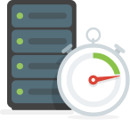

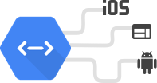
Cloud Endpoints help you create and maintain APIs
Protection
Speed
Monitoring and logging
Integration
Generate and share API keys.
Validate calls with JSON Web Tokens.
Identify app users with Auth0 and Firebase Auth.
ESP provides security and insight < 1ms.
Automatic API deployment.
Inspect performance with Cloud Trace.
Real-time log management with Cloud Logging.
Analysis with BigQuery.
Choose your own framework and language.
Upload an OpenAPI specification and deploy Google’s containerized proxy.
Copyright Google LLC. For educational purposes in accordance with the terms of use set forth on the program Website.
Notes:
Cloud Endpoints is a distributed API management system.
With Cloud Endpoints you can control who has access to your API. You can generate API keys in the Cloud Console and validate on every API call and share your API with other developers to allow them to generate their own keys. You can also validate calls with JSON Web Tokens. The integration with Auth0 and Firebase Authentication allows you to identify the users of your web or mobile application.
The Extensible Service Proxy delivers security and insight in less than 1 millisecond per call. You can deploy your API automatically with App Engine and Google Kubernetes Engine, or add Google’s proxy container to your Kubernetes deployment.
You can monitor critical operations metrics, such as error rates and latency, in the Cloud Console and gain insight into your users and usage with Cloud Trace and Cloud Logging. You can use BigQuery to perform further analysis.
You can get started quickly by using your favorite API framework and language, or choose Google’s open source Cloud Endpoints Frameworks in Java or Python. You can also simply upload an OpenAPI specification and deploy Google’s containerized proxy.

Slide 13
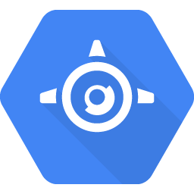
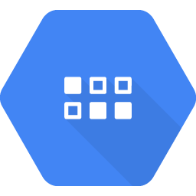

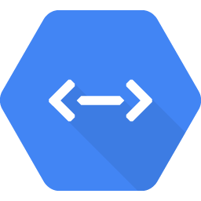
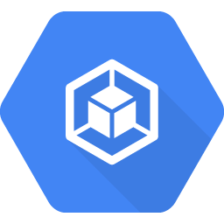
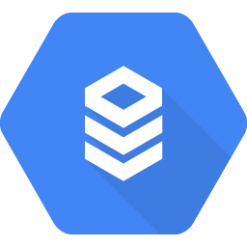

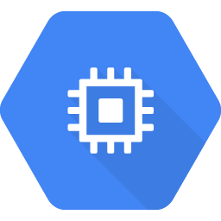
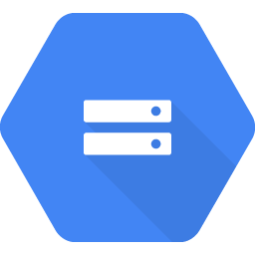
Where Cloud Endpoints fit
Runtime environments
Backend services
Mobile and web client applications
Backend API
Javascript
App Engine
Datastore
iOS
GKE
Cloud SQL
Cloud Endpoints
Android
Compute Engine
Cloud Storage
...
Copyright Google LLC. For educational purposes in accordance with the terms of use set forth on the program Website.
Notes:
Cloud Endpoints support applications running in Google Cloud’s compute platforms, in your choice of languages, and your choice of client technologies.
It allows you to establish a standardized API for mobile or web client applications to enable them to connect to and use a backend application on App Engine. It also provides the mobile or web application access to the full resources of App Engine.

Slide 14
Cloud Endpoints makes it easier to deploy and manage APIs
Authentication and authorization
Interface definition
Open API
gRPC API
Cloud Endpoints
Service-to-service authentication
User authentication
Extensible Service Proxy Service Management
Service Control
Cloud Logging
Cloud Trace
Management and scalability
Logging and monitoring
Copyright Google LLC. For educational purposes in accordance with the terms of use set forth on the program Website.
Notes:
In the previous topic, we discussed how it can be difficult to deploy and manage APIs on your own. This graphic summarizes how Cloud Endpoints provides the infrastructure support needed to deploy and manage robust, secure, and scalable APIs.
Cloud Endpoints supports the Open API specification and gRPC API specification.
Cloud Endpoints also supports service-to-service authentication and user authentication with Firebase, Auth0, and Google authentication.
The Extensible Service Proxy, Service Management, and Service Control together validate requests, log data, and handle high volumes of traffic
Logging and Trace allows you to view detailed logs, trace lists, and metrics related to traffic volume, latency, size of requests and responses, and errors.

Slide 15
Agenda
The Purpose of APIs
Cloud Endpoints
Lab: Cloud Endpoints: Qwik Start
Using Apigee Edge
Managed Message Services
Pub/Sub
Copyright Google LLC. For educational purposes in accordance with the terms of use set forth on the program Website.
Notes:
Next, we’ll see Cloud Endpoints in action through a hands-on lab.

Slide 16
Lab Intro
Cloud Endpoints: Qwik Start
Deploy a sample API with Google Cloud Endpoints and view the Cloud Endpoints Activity Graphs and Logs.
The lab can be found here.
Copyright Google LLC. For educational purposes in accordance with the terms of use set forth on the program Website.
Notes:
In this lab, we’ll deploy a sample API with Cloud Endpoints and view the Cloud Endpoints Activity Graphs and Logs.

Slide 17
Lab objectives
Deploy the Cloud Endpoints configuration.
Deploy the API backend.
Send requests to the API.
Track API activity.
Add a quota to the API.
Copyright Google LLC. For educational purposes in accordance with the terms of use set forth on the program Website.
Notes:
By completing this lab, you’ll learn how to deploy the Cloud Endpoints configuration, deploy the API backend, send requests to the API, track API activity, and add a quota to rate-limit the API.

Slide 18
Lab
Introduction to APIs in Google (Alternative)
Configure and run Cloud Storage API methods in Cloud Shell.
The lab can be found here.
Copyright Google LLC. For educational purposes in accordance with the terms of use set forth on the program Website.
Notes:
In this lab, you’ll learn about the architecture and basic functioning of APIs. This will be supplemented with hands-on practice, where you’ll configure and run Cloud Storage API methods in Google Cloud Shell. After taking this lab you’ll understand key principles of API communication, architecture, and authentication. You’ll also gain practical experience with APIs, which you can apply to future labs or projects.

Slide 19
Lab objectives
Learn about the architecture and basic functioning of APIs.
Create a JSON file in the Cloud Console.
Authenticate and authorize the Cloud Storage JSON/REST API.
Create a bucket with the Cloud Storage JSON/REST API.
Upload a file using the Cloud Storage JSON/REST API.
Copyright Google LLC. For educational purposes in accordance with the terms of use set forth on the program Website.
Notes:
By completing this lab, you’ll learn about the architecture and basic functioning of APIs.
You’ll then create a JSON file in the Cloud Console, authenticate and authorize the Cloud Storage JSON/REST API, and then create a bucket and upload a file using the Cloud Storage JSON/REST API.

Slide 20
Agenda
The Purpose of APIs
Cloud Endpoints
Lab: Cloud Endpoints: Qwik Start
Using Apigee Edge
Managed Message Services
Pub/Sub
Copyright Google LLC. For educational purposes in accordance with the terms of use set forth on the program Website.
Notes:
In this topic, we’ll look at Apigee Edge, another platform for managing APIs.

Slide 21
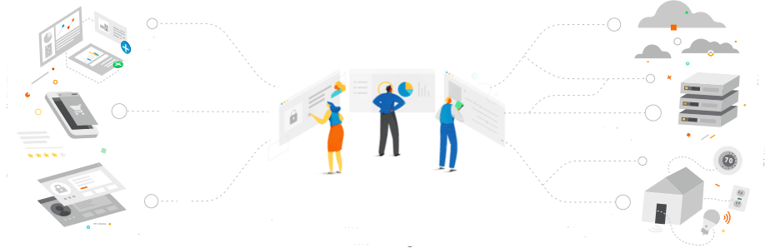

Apigee Edge is a platform for developing and managing APIs
Partner apps
Cloud apps
Consumer apps
Systems of record
Employee apps
Internet of Things
Connected experiences
Design, Secure, Publish, Analyze, Monitor, and Monetize APIs Manage microservices, Leverage developer portal
Backend systems
Copyright Google LLC. For educational purposes in accordance with the terms of use set forth on the program Website.
Notes:
Apigee Edge allows you to front your services with a proxy layer. An API proxy is your interface to developers that want to use your backend services. Rather than having them consume those services directly, they access an Edge API proxy that you create. With a proxy, you can provide value-added features such as security, rate limiting, quotas, caching and persistence, analytics, transformations, fault handling, and much more.
Many users of Apigee Edge are providing a software service to other companies, and those features come in handy. Because the backend services for Apigee Edge need not be in Google Cloud, engineers also often use it when they are working to take a legacy application apart. Instead of replacing a monolithic application in one risky move, they can instead use Apigee Edge to peel off its services one by one, standing up microservices to implement each in turn, until the legacy application can finally be retired.

Slide 22





An API gateway enables clients to retrieve data from multiple services with a single request
/account
Backend application component on Google Cloud
/order
/history
Cloud Endpoints
/payment
/creditgateway
Partner, consumer, and employee apps
/rewards
APIs
Legacy app
Copyright Google LLC. For educational purposes in accordance with the terms of use set forth on the program Website.
Notes:
An API gateway creates a layer of abstraction and insulates the clients from the partitioning of the application into microservices.
You can use Cloud Endpoints to implement API gateways. Additionally, the API for your application can run on backends such as App Engine, Google Kubernetes Engine, or Compute Engine.
If you have legacy applications that cannot be refactored and moved to the cloud, consider implementing APIs as a facade or adapter layer. Each consumer can then invoke these modern APIs to retrieve information from the backend instead of implementing functionality to communicate using outdated protocols and disparate interfaces.

Slide 23
Agenda
The Purpose of APIs
Cloud Endpoints
Lab: Cloud Endpoints: Qwik Start
Using Apigee Edge
Managed Message Services
Pub/Sub
Copyright Google LLC. For educational purposes in accordance with the terms of use set forth on the program Website.
Notes:
Next, we’ll learn about the use cases for managed message services.

Slide 24


Organizations have to rapidly ingest, transform, and analyze massive amounts of data
Endpoint clients
Mobile
iOS
User and device data
Ingest
Transform
Analyze
User experience
Web
Android
IoT
Web
Copyright Google LLC. For educational purposes in accordance with the terms of use set forth on the program Website.
Notes:
Across industry verticals, a common scenario is that organizations have to rapidly ingest, transform, and analyze massive amounts of data. For example, a gaming application might receive and process user engagement and clickstream data. In the shipping industry, IoT (Internet of Things) applications might receive large amounts of sensor data from hundreds of sensors. Data processing applications transform the ingested data and save it in an analytics database. You can then analyze the data to provide business insights and create innovative user experiences.

Slide 25

Organizations have to orchestrate complex
business processes
Frontend
US West
Frontend
US West
Frontend
US East
Frontend
US East
Frontend
EU
Frontend
EU
FriendList
service
PayLabel
Service
Recommend- ations
Top10
service
Copyright Google LLC. For educational purposes in accordance with the terms of use set forth on the program Website.
Notes:
Organizations often have complex business processes that require many applications to interact with each other. For example, when a user plays a song, a music streaming service must perform many operations in the background. There might be operations to: pay the record company, perform live updates to the catalog, update song recommendations, handle ad interaction events, and perform analytics on user actions. Such complex application interactions are difficult to manage with brittle point-to-point application connections.

Slide 26
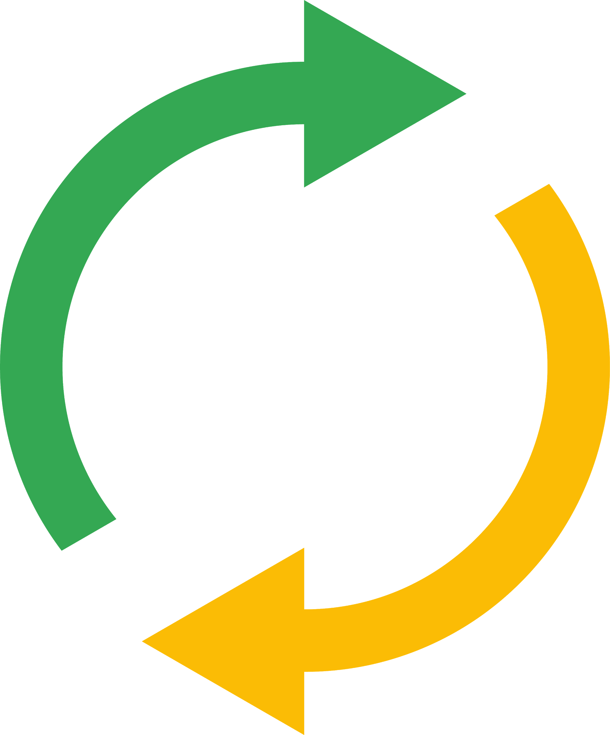


Use cases for a managed messaging system
Upstream service
Downstream service
Balance workloads in network clusters
Implement asynchronous workflows
Distribute event notifications
Refresh distributed caches
Log to multiple systems
Stream data from various processes or devices
Reliability improvement
Copyright Google LLC. For educational purposes in accordance with the terms of use set forth on the program Website.
Notes:
There are many different reasons why a managed messaging system might be used.
Balancing workloads in network clusters, for example, a large queue of tasks can be efficiently distributed among multiple workers, such as Compute Engine instances.
Implementing asynchronous workflows, for example, an order processing application can place an order on a topic, from which it can be processed by one or more workers.
Distributing event notifications, for example, a service that accepts user signups can send notifications whenever a new user registers, and downstream services can subscribe to receive notifications of the event.
Refreshing distributed caches, for example, an application can publish invalidation events to update the IDs of objects that have changed.
Logging to multiple systems, for example, a Compute Engine instance can write logs to the monitoring system, to a database for later querying, and so on.
Data streaming from various processes or devices, for example, a residential sensor can stream data to backend servers hosted in the cloud.
Reliability improvement, for example, a single-zone Compute Engine service can operate in additional zones by subscribing to a common topic, to recover from failures in a zone or region.

Slide 27
Agenda
The Purpose of APIs
Cloud Endpoints
Lab: Cloud Endpoints: Qwik Start
Using Apigee Edge
Managed Message Services
Pub/Sub
Copyright Google LLC. For educational purposes in accordance with the terms of use set forth on the program Website.
Notes:
Pub/Sub is Google’s managed message service, and we’ll learn about this next.

Slide 28
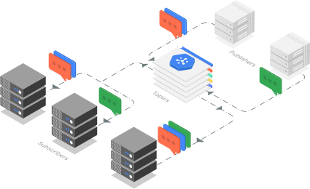
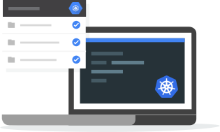
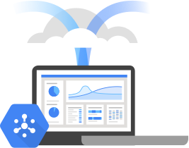
Pub/Sub simplifies global messaging and event ingestion
Ingest events at any scale
Simple development of event-driven microservices
Be production ready from day one
No provisioning, partitioning, or load isolation worries.
Expand with global topics.
Enrich, deduplicate, order, aggregate, and land events using Dataflow.
Durable storage.
Reliable delivery of each event to the services that must react to it.
Push subs deliver the event to serverless apps.
Pull subs make events available to more complex stateful services.
Multi-region environments operate seamlessly.
End-to-end encryption, IAM, and audit logging.
NoOps, fully automated scaling and provisioning.
Extreme data durability and availability.
Native client libraries and an open-service API
Copyright Google LLC. For educational purposes in accordance with the terms of use set forth on the program Website.
Notes:
Pub/Sub is a real-time messaging service that allows you to capture data and rapidly pass massive amounts of messages between other Google Cloud services and other software applications. Think of it as a connector that removes the time you would typically spend managing operations.
One of the primary use cases for inter-app messaging is to ingest streaming event data. Pub/Sub provides a simple and reliable staging location for your event data on its journey towards processing, storage, and analysis. It allows you to scale without provisioning, partitioning, or load isolation worries, expand your applications and pipelines to new regions simply with global topics, enrich, deduplicate, order, aggregate, and land events using Dataflow, and mix real-time and batch processing through the durable storage of Pub/Sub.
Pub/Sub allows you to make your events accessible through messaging middleware. Pub/Sub will reliably deliver each event to the services that must react to it. Upon event publication to Pub/Sub, push subscriptions deliver the event to serverless apps running in Cloud Functions, App Engine or Cloud Run. Pull subscriptions make it available to more complex stateful services running in Google Kubernetes Engine or Dataflow, and multi-region environments operate seamlessly because of the global nature of Pub/Sub.
Pub/Sub lets you focus on application logic, regardless of location or scale. The service is minimal and easy to start with but also eliminates the operational, scaling, compliance, and security surprises that inevitably reveal themselves in software projects. Always-on features include end-to-end encryption, IAM, and audit logging, as well as NoOps, fully automated scaling and provisioning with virtually unlimited throughput. Further features of Pub/Sub include extreme data durability and availability with synchronous cross-zone replication, as well as native client libraries in major languages and an open-service API.

Slide 29
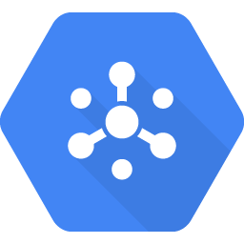
Pub/Sub is used between data gathering and processing systems
HR system
Person-hired event “message”
Pub/Sub
HR “topic”
Employee directory service
Badge activation system
Email account provisioning
Facilities system
Copyright Google LLC. For educational purposes in accordance with the terms of use set forth on the program Website.
Notes:
Because Pub/Sub is positioned between applications, it’s called middleware.
For example, if an organization is hiring a new employee, the company's HR system could use Pub/Sub to notify their other business systems that a new employee has been hired, pass on relevant information, and initiate actions. Pub/Sub is often found in the "middle" of systems like this.

Slide 30
Pub/Sub uses the Publish-Subscribe pattern
Publisher
Message
Pub/Sub
Topic
Message
store
Subscription
Message
Subscriber
Copyright Google LLC. For educational purposes in accordance with the terms of use set forth on the program Website.
Notes:
Publisher applications can send messages to a topic and subscriber applications can subscribe to that topic to receive the message when the subscriber is ready. This can take place asynchronously.
It’s important to understand that subscribers only receive messages from the initial publisher.
It’s best practice when using Pub/Sub with Google Cloud tools to specify a subscription instead of a topic for reading.

Slide 31
Pub/Sub acts as a buffer between sending and receiving across software applications
Push subscription
Pull subscription
Pub/Sub
Pub/Sub
Legend
Acknowledge
Message
HTTP POST request
HTTP GET request
HTTP response
Message
Request
Acknowledge
Subscriber
Subscriber
Copyright Google LLC. For educational purposes in accordance with the terms of use set forth on the program Website.
Notes:
Pub/Sub acts as a buffer between sending and receiving across software applications, which makes it easier for developers to connect applications. For example, Pub/Sub can be used to guarantee the email messages get delivered swiftly to online users as well as offline users, when they come back online.
Pub/Sub can act as a shock absorber within the architecture. If there's a sudden influx of messages, Pub/Sub avoids the risk of overwhelming the consumers of those messages because it will absorb the sudden increase in messages and the consumers can continue to pull as many messages as they can handle at once.
Messages can be pushed to any secure web server, or pulled from anywhere on the Internet.

Slide 32
A slightly more complex setup of Pub/Sub
Publisher A
Publisher B
Publisher C
Message 1
Message 2
Message 3
Pub/Sub
Topic A
Topic B
Topic C
Subscription XA
Subscription XB
Subscription YC
Subscription ZC
Message 1
Message 2
Message 3
Message 3
Subscriber X
Subscriber Y
Subscriber Z
Copyright Google LLC. For educational purposes in accordance with the terms of use set forth on the program Website.
Notes:
This topology represents a slightly more complex setup of Pub/Sub. Note that everything in the green box is part of the Pub/Sub managed service. You would supply the publishers and subscribers by writing applications or leveraging other managed services.

Slide 33
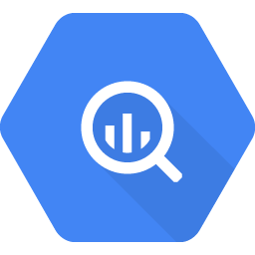
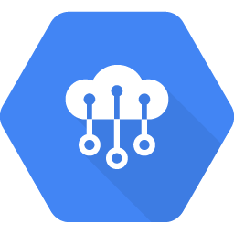
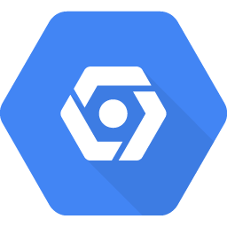

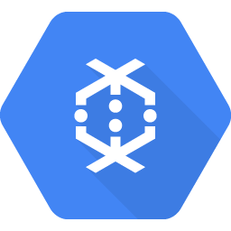
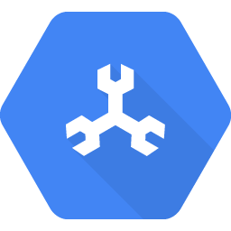
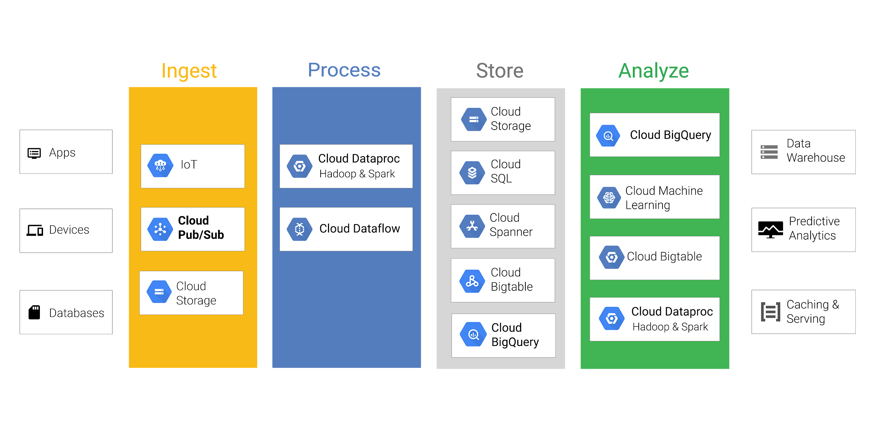
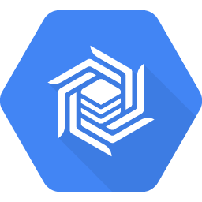
The position of Pub/Sub within the big data processing model
Ingest
Process
Store
Analyze
Cloud Storage
Apps
BigQuery
Data
Warehouse
IoT
Dataproc
Hadoop & Spark
Cloud SQL
AI Platform
Devices
Pub/Sub
Dataflow
Cloud Spanner
Predictive Analytics
Cloud Bigtable
Cloud Storage
Cloud Bigtable
Databases
Dataproc
Hadoop & Spark
Caching & Serving
BigQuery
Copyright Google LLC. For educational purposes in accordance with the terms of use set forth on the program Website.
Notes:
Within the common big data processing model, Pub/Sub is found in the Ingest phase. Let’s explore the rest of this diagram.
The first step in processing data is capturing and bringing it into the system. Google Cloud has several tools to help with this, including Cloud IoT and Pub/Sub. Pub/Sub ingests event streams from anywhere, at any scale, for simple, reliable, real-time stream analytics.
The second step is to process the data. Google Cloud tools during this stage include Dataproc and Dataflow.
The third step is to store the data and ensure it has the right accessibility needed. Google Cloud tools in this stage include Cloud Storage, Cloud SQL, Cloud Spanner, and Cloud Bigtable.
Finally, users are looking to analyze the data to capture insights. Google Cloud products for this stage include BigQuery, Cloud Bigtable, AI Platform, and Dataproc.

Slide 34
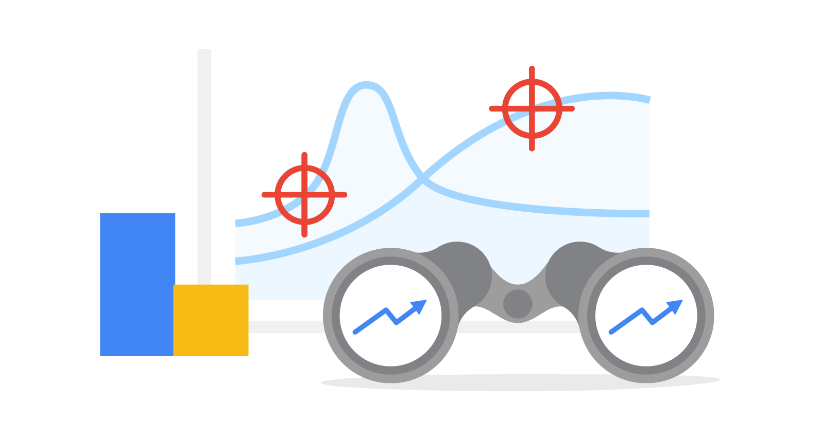
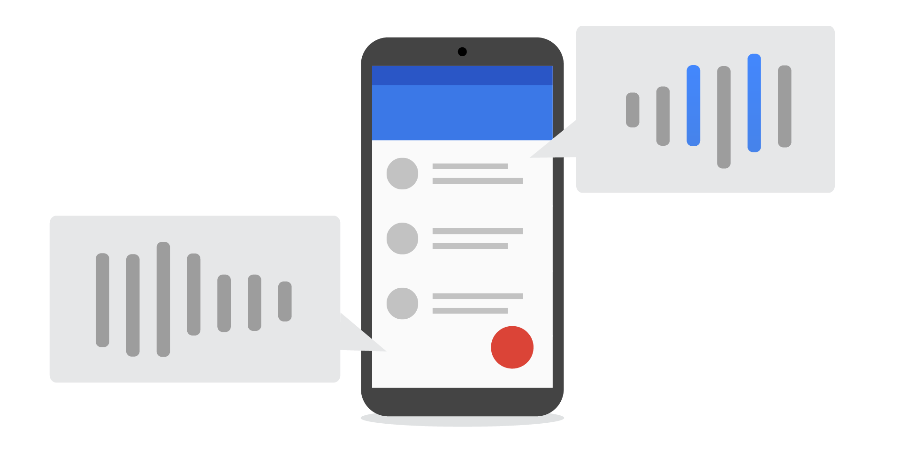
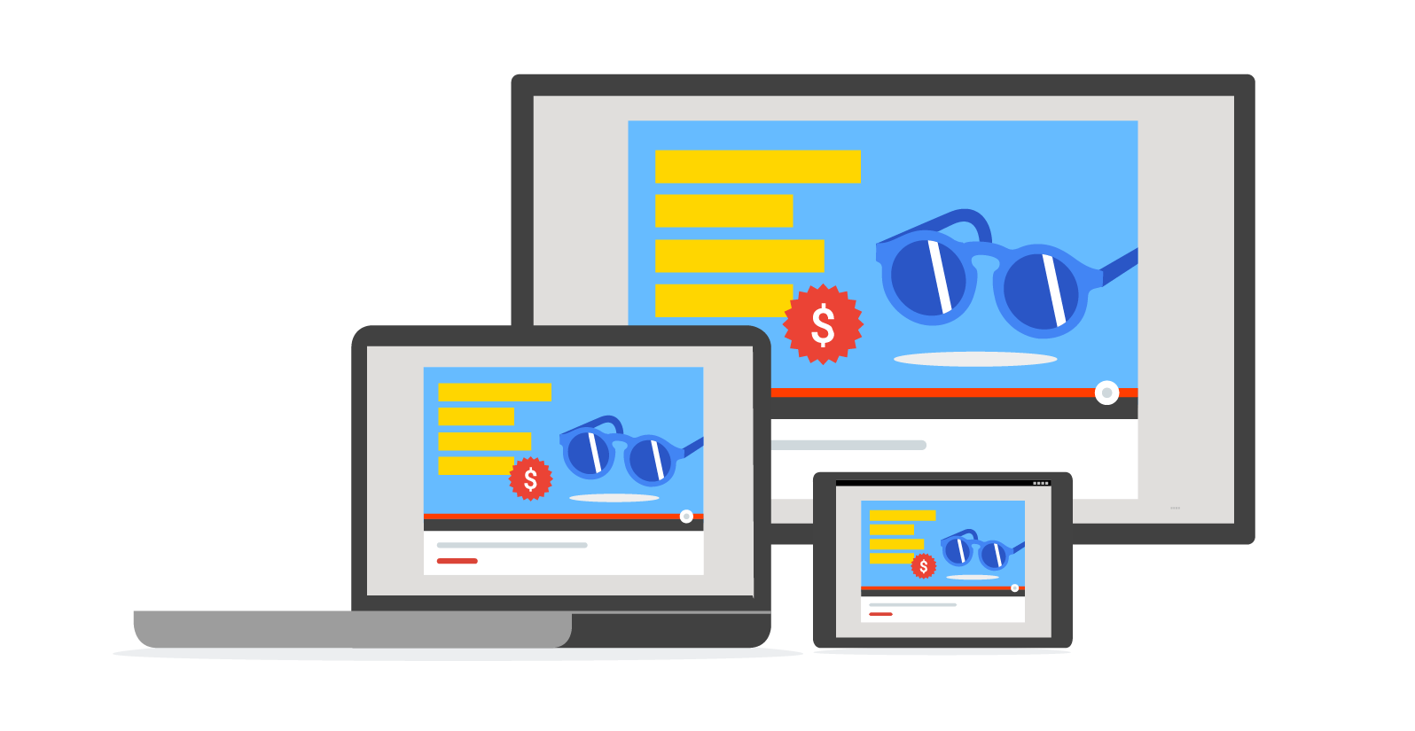
Examples of Pub/Sub working
Chat and mobile
Instant search
Ads and budgets
Copyright Google LLC. For educational purposes in accordance with the terms of use set forth on the program Website.
Notes:
There are many examples of Pub/Sub working.
Every time your Gmail displays a new message, it’s because of a push notification to your browser or mobile device.
The updating of search results as you type is a feat of real-time indexing that depends on Pub/Sub to update caches with breaking news.
One of the most important real-time information streams for some companies is advertising revenue. They can use Pub/Sub to broadcast budgets to their entire fleet of search engines.

Slide 35
Agenda
Lab: Cloud Pub/Sub: Qwik Start - Python
Quiz
Summary
Copyright Google LLC. For educational purposes in accordance with the terms of use set forth on the program Website.
Notes:
Next, we’ll learn more about Pub/Sub though a hands-on lab.

Slide 36
Lab Intro
Google Cloud Pub/Sub: Qwik Start - Python
Publish messages with Pub/Sub using the Python client library.
You can find the lab here.
Copyright Google LLC. For educational purposes in accordance with the terms of use set forth on the program Website.
Notes:
In this lab, we’ll publish messages with Pub/Sub using the Python client library.

Slide 37
Lab objectives
Learn the basics of Pub/Sub.
Create and list a Pub/Sub topic.
Create and list a Pub/Sub subscription.
Publish messages to a topic.
Use a pull subscriber to output individual topic messages.
Copyright Google LLC. For educational purposes in accordance with the terms of use set forth on the program Website.
Notes:
By completing this lab, you’ll learn the basics of Pub/Sub, create and list a Pub/Sub topic, create and list a Pub/Sub subscription, publish messages to a topic, and use a pull subscriber to output individual topic messages.

Slide 38
Lab Intro
Google Cloud Pub/Sub: Qwik Start - Console (Alternative)
Publish messages with Pub/Sub using the Cloud Console.
You can find the lab here.
Copyright Google LLC. For educational purposes in accordance with the terms of use set forth on the program Website.
Notes:
In this lab, we’ll publish messages with Pub/Sub using the Cloud Console.

Slide 39
Lab objectives
Set up a topic to hold data.
Subscribe to a topic to access the data.
Publish and then consume messages with a pull subscriber.
Copyright Google LLC. For educational purposes in accordance with the terms of use set forth on the program Website.
Notes:
By completing this lab, you’ll set up a topic to hold data, subscribe to a topic to access the data, and publish and then consume messages with a pull subscriber.

Slide 40
Agenda
Lab: Cloud Pub/Sub: Qwik Start - Python
Quiz
Summary
Copyright Google LLC. For educational purposes in accordance with the terms of use set forth on the program Website.
Notes:
Finally, let's reinforce what you learned with a quick quiz.

Slide 41
Scenario #1
Question
Select the option that is not a feature of Pub/Sub.
A global service
Does both push and pull messaging
Can process messages as they enter the queue.
Can hold millions of messages
Copyright Google LLC. For educational purposes in accordance with the terms of use set forth on the program Website.
Notes:
Select the option that is not a feature of Pub/Sub.

Slide 42
Scenario #1
Answer
Select the option that is not a feature of Pub/Sub.
A global service
Does both push and pull messaging
Can process messages as they enter the queue.
Can hold millions of messages
Copyright Google LLC. For educational purposes in accordance with the terms of use set forth on the program Website.
Notes:
Pub/Sub is not a messaging processing service. You write your applications to process the messages stored in Pub/Sub.

Slide 43
Scenario #2
Question
Which of the following API Management Systems can be used on legacy systems?
Apigee Edge
Cloud Endpoints
Cloud Gateway
REST
Copyright Google LLC. For educational purposes in accordance with the terms of use set forth on the program Website.
Notes:
Which of the following API Management Systems can be used on legacy systems?

Slide 44
Scenario #2
Answer
Which of the following API Management Systems can be used on legacy systems?
Apigee Edge
Cloud Endpoints
Cloud Gateway
REST
Copyright Google LLC. For educational purposes in accordance with the terms of use set forth on the program Website.
Notes:
Apigee Edge is designed to be used with both cloud and legacy systems.

Slide 45
Scenario #3
Question
What protocol is used by REST APIs?
SSH
Telnet
ICMP
HTTP
Copyright Google LLC. For educational purposes in accordance with the terms of use set forth on the program Website.
Notes:
What protocol is used by REST APIs?

Slide 46
Scenario #3
Answer
What protocol is used by REST APIs?
SSH
Telnet
ICMP
HTTP
Copyright Google LLC. For educational purposes in accordance with the terms of use set forth on the program Website.
Notes:
HTTPS is the protocol used with REST APIs.

Slide 47
Agenda
Lab: Cloud Pub/Sub: Qwik Start - Python
Quiz
Summary
Copyright Google LLC. For educational purposes in accordance with the terms of use set forth on the program Website.

Slide 48
Summary (1/2)
APIs are software structures that present easy to understand interfaces and remove needless detail.
REST APIs ensure apps can communicate.
There are a number of issues to consider as part of the API design and development process.
Cloud Endpoints is a distributed API management system that helps you create and maintain APIs.
Apigee Edge is a platform for developing and managing API proxies.
Copyright Google LLC. For educational purposes in accordance with the terms of use set forth on the program Website.
Notes:
This module begun by explaining that APIs are software structures written so that they present clean, well-defined, interfaces that removes needless detail.
Next, you discovered that using REST APIs ensures that legacy and newly created apps can communicate clearly with each other. You also found out that when designing and developing your APIs, you need to make a range of considerations that include: the interface, authorization and authentication, management and scalability, and logging and monitoring.
The next part of the module focussed on different tools that you can use to manage your APIs. This included Cloud Endpoints, which is a distributed API management system that helps you create and maintain APIs, and Apigee Edge, a platform for developing and managing API proxies. It wraps around the APIs and has a business focus (i.e. rate limiting, quotas, analytics).

Slide 49
Summary (2/2)
A managed messaging system ingests, transforms, and analyzes massive amounts of data. It also orchestrates complex business processes.
Pub/Sub passes messages between data gathering and processing systems.
Copyright Google LLC. For educational purposes in accordance with the terms of use set forth on the program Website.
Notes:
You then moved on to learning about managed messaging systems. They ingest, transform, and analyze massive amounts of data. They also orchestrate complex business processes.
Finally you learned that Pub/Sub passes messages between data gathering and processing systems. Pub/Sub is a service to help customers capture data and rapidly pass massive amounts of messages between other Google Cloud big data tools and other software applications with world-class security.

